Slide 1



Objectives
Become aware of Oracle8i Release 2 (8.1.6) Analytic Functions at a high level
Learn about the Cube and Rollup enhancements to GROUP BY
Know how to use the Cube, Rollup to enhance systems

Slide 2
Oracle8i Version 2 (8.1.6) Analytic Functions
Oracle 8.1.6 includes a new set of functions designed to provide expanded support for data mining operations -
(this topic is too rich to fully cover in the context of this paper)
The analytic functions are divided into four "families"
Lag/Lead Compares values of rows to other rows in same table: LAG, LEAD
Ranking Supports "top n" queries: CUME_DIST, DENSE_RANK, NTILE, PERCENT_RANK, RANK, ROW_NUMBER
Reporting Aggregate Compares aggregates to non-aggregates (pct of total):
RATIO_TO_REPORT
Window Aggregate Moving average type queries: FIRST_VALUE, LAST_VALUE
The analytic functions allow users to divide query result sets into ordered groups of rows called partitions
(not the same as database partitions)

Slide 3
Oracle8i Version 2 (8.1.6) Analytic Function Clauses
Along with the new functions came new clauses (again, too rich to cover completely here):
analytic_function ( ) OVER (analytic clause)
Analytic clause
Query_partition_clause-Order_by clause-Windowing clause
Query partition clause
PARTITION BY list,of,cols
Windowing clause
RANGE … or
– Order by clause
ORDER BY col,list
ROWS ...

Slide 4
Analyzing across Multiple Dimensions
One of the key concepts in decision support systems is "multi-dimensional analysis":
examining the enterprise from all necessary combinations of dimensions.
We use the term "dimension" to mean any category used in specifying questions. Among the most commonly specified dimensions are time, geography, product, department, and distribution channel, but the potential dimensions are as endless as the varieties of enterprise activity.
The events or entities associated with a particular set of dimension values are usually referred to as "facts." The facts may be sales in units or local currency, profits, customer counts, production volumes, or anything else worth tracking.
Here are some examples of multi-dimensional requests:
Show total sales across all products at increasing aggregation levels: from state to country to region for 1996 and 1997.
Create a cross-tabular analysis of our operations showing expenses by territory in South America for 1996 and 1997. Include all possible subtotals.
List the top 10 sales representatives in Asia according to 1997 sales revenue in for automotive products and rank their commissions.
All the requests above constrain multiple dimensions. Many multi-dimensional questions require aggregated data and comparisons of data sets, often across time, geography or budgets.

Slide 5
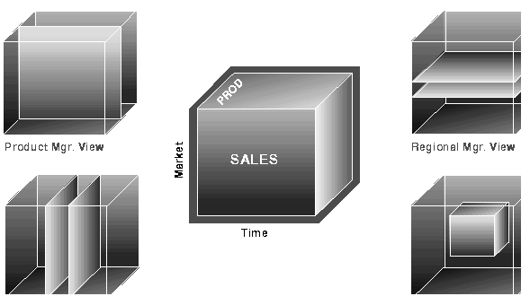
Cube and Views by Different Users
To visualize data that has many dimensions, analysts commonly use the analogy of a data "cube," that is, a space where facts are stored at the intersection of n dimensions.
Figure 20-1 shows a data cube and how it could be used differently by various groups.
The cube stores sales data organized by the dimensions of Product, Market, and Time.

Slide 6
Optimized Performance
Not only multi-dimensional issues, but all types of processing can benefit from enhanced aggregation facilities.
Transaction processing, financial and manufacturing systems--all of these generate large numbers of production reports needing substantial system resources.
Improved efficiency when creating these reports will reduce system load.
In fact, any computer process that aggregates data from details to higher levels needs optimized performance.
To leverage the power of the database server, powerful aggregation commands should be available inside the SQL engine.
New extensions in Oracle provide these features and bring many benefits, including:
Simplified programming requiring less SQL code for many tasks
Quicker and more efficient query processing
Reduced client processing loads and network traffic because aggregation work is shifted to servers
Opportunities for caching aggregations because similar queries can leverage existing work
Oracle8i provides all these benefits with the new CUBE and ROLLUP extensions to the GROUP BY clause.
These extensions adhere to the ANSI and ISO proposals for SQL3, a draft standard for enhancements to SQL.

Slide 7
A Scenario
To illustrate CUBE, ROLLUP, and Top-N queries, this chapter uses a hypothetical videotape sales and rental company.
All the examples given refer to data from this scenario
The hypothetical company has stores in several regions and tracks sales and profit information.
The data is categorized by three dimensions: Time, Department, and Region.
The time dimensions are 1996 and 1997, the departments are Video Sales and Video Rentals, and the regions are East, West, and Central.
Table 20-1 Simple Cross-Tabular Report, with Subtotals Shaded

Slide 8
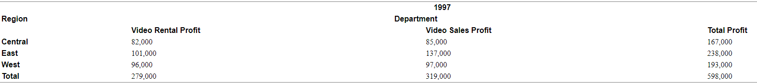
A Scenario
Table 20-1 Simple Cross-Tabular Report, with Subtotals Shaded
Consider that even a simple report like Table 20-1, with just twelve values in its grid, needs five subtotals and a grand total.
The subtotals are the shaded numbers, such as Video Rental Profits across regions, namely, 279,000, and Eastern region profits across department,
namely, 238,000.
Half of the values needed for this report would not be calculated with a query that used a standard SUM() AND GROUPBY()
Database commands that offer improved calculation of subtotals bring major benefits to querying, reporting and analytical operations.

Slide 9
ROLLUP
ROLLUP enables a SELECT statement to calculate multiple levels of subtotals across a specified group of dimensions.
It also calculates a grand total.
ROLLUP is a simple extension to the GROUP BY clause, so its syntax is extremely easy to use.
The ROLLUP extension is highly efficient, adding minimal overhead to a query.
Syntax
ROLLUP appears in the GROUP BY clause in a SELECT statement.
Its form is:
SELECT ... GROUP BY ROLLUP(grouping_column_reference_list)

Slide 10
Details
ROLLUP's action is straightforward: it creates subtotals which "roll up" from the most detailed level to a grand total, following a grouping list specified in the ROLLUP clause.
ROLLUP takes as its argument an ordered list of grouping columns.
First, it calculates the standard aggregate values specified in the GROUP BY clause.
Then, it creates progressively higher-level subtotals, moving from right to left through the list of grouping columns.
Finally, it creates a grand total.
ROLLUP will create subtotals at n+1 levels, where n is the number of grouping columns.
For instance, if a query specifies ROLLUP on grouping columns of Time, Region, and Department ( n=3), the result set will include rows at four aggregation levels.

Slide 11
Example
This example of ROLLUP uses the data in the video store database.
SELECT Time, Region, Department, sum(Profit) AS Profit
FROM sales
GROUP BY ROLLUP(Time, Region, Dept)
As you can see in Table 20-2, this query returns the following sets of rows:
Regular aggregation rows that would be produced by GROUP BY without using ROLLUP
First-level subtotals aggregating across Department for each combination of Time and Region
Second-level subtotals aggregating across Region and Department for each Time value
A grand total row

Slide 12
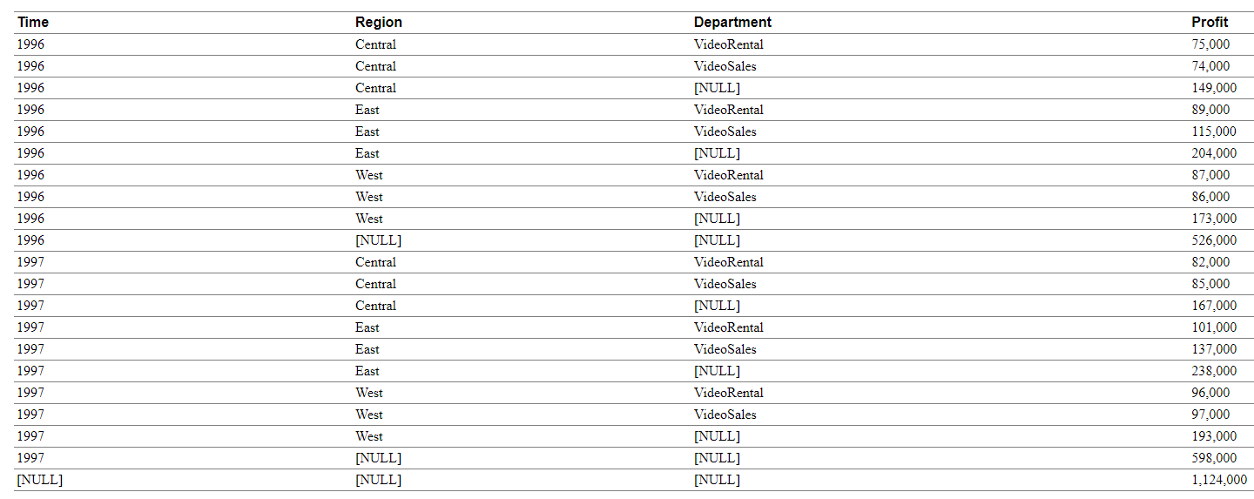
Example

Slide 13
Interpreting "[NULL]" Values in Results
The NULL values returned by ROLLUP and CUBE are not always the traditional NULL value meaning "value unknown."
Instead, a NULL may indicate that its row is a subtotal.
For instance, the first NULL value shown in Table 20-2 is in the Department column.
This NULL means that the row is a subtotal for "All Departments" for the Central region in 1996.
To avoid introducing another non-value in the database system, these subtotal values are not given a special tag.
Note:The NULLs shown in the figures of this paper are displayed only for clarity: in standard Oracle output these cells would be blank.

Slide 14
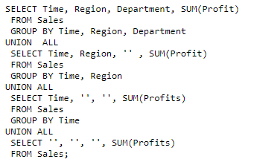
Calculating Subtotals without ROLLUP
The result set in Table 20-1 could be generated by the UNION of four SELECT statements, as shown below.
This is a subtotal across three dimensions.
Notice that a complete set of ROLLUP-style subtotals in n dimensions would require n+1 SELECT statements linked with UNION ALL.

Slide 15
Calculating Subtotals without ROLLUP
The approach shown in the SQL above has two shortcomings compared to using the ROLLUP operator.
First, the syntax is complex, requiring more effort to generate and understand.
Second, and more importantly, query execution is inefficient because the optimizer receives no guidance about the user's overall goal.
Each of the four SELECT statements above causes table access even though all the needed subtotals could be gathered with a single pass.
The ROLLUP extension makes the desired result explicit and gathers its results with just one table access.
The more columns used in a ROLLUP clause, the greater the savings versus the UNION approach.
For instance, if a four-column ROLLUP replaces a UNION of 5 SELECT statements, the reduction in table access is four-fifths or 80%.
Some data access tools calculate subtotals on the client side and thereby avoid the multiple SELECT statements described above.
While this approach can work, it places significant loads on the computing environment.
For large reports, the client must have substantial memory and processing power to handle the subtotaling tasks.
Even if the client has the necessary resources, a heavy processing burden for subtotal calculations may slow down the client in its performance of other activities.

Slide 16
When to Use ROLLUP
Use the ROLLUP extension in tasks involving subtotals.
It is very helpful for subtotaling along a hierarchical dimension such as time or geography.
For instance, a query could specify a ROLLUP of year/month/day or country/state/city.
It simplifies and speeds the population and maintenance of summary tables.
Data warehouse administrators may want to make extensive use of it.
Note that population of summary tables is even faster if the ROLLUP query executes in parallel.

Slide 17
CUBE
Note that the subtotals created by ROLLUP are only a fraction of possible subtotal combinations.
For instance, in the cross-tab shown in Table 20-1, the departmental totals across regions (279,000 and 319,000) would not be calculated by a ROLLUP(Time, Region, Department) clause.
To generate those numbers would require a ROLLUP clause with the grouping columns specified in a different order:
ROLLUP(Time, Department, Region). The easiest way to generate the full set of subtotals needed for cross-tabular reports such as those needed for
Figure 20-1 is to use the CUBE extension.

Slide 18
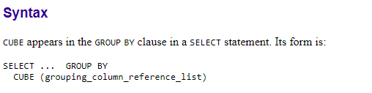
CUBE
CUBE enables a SELECT statement to calculate subtotals for all possible combinations of a group of dimensions.
It also calculates a grand total.
This is the set of information typically needed for all cross-tabular reports, so CUBE can calculate a cross-tabular report with a single SELECT statement.
Like ROLLUP, CUBE is a simple extension to the GROUP BY clause, and its syntax is also easy to learn.

Slide 19
Details
CUBE takes a specified set of grouping columns and creates subtotals for all possible combinations of them.
In terms of multi-dimensional analysis, CUBE generates all the subtotals that could be calculated for a data cube with the specified dimensions.
If you have specified CUBE(Time, Region, Department), the result set will include all the values that would be included in an equivalent ROLLUP statement plus additional combinations.
For instance, in Table 20-1, the departmental totals across regions (279,000 and 319,000) would not be calculated by a ROLLUP(Time, Region, Department) clause, but they would be calculated by a CUBE(Time, Region, Department) clause. If there are n columns specified for a CUBE, there will be 2n combinations of subtotals returned.
Table 20-3 gives an example of a three-dimension CUBE.

Slide 20
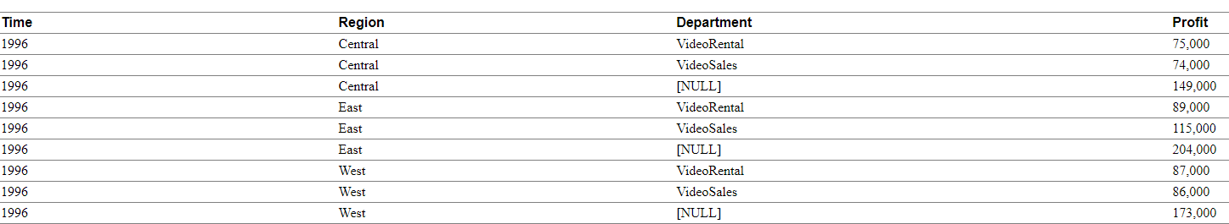
Example
This example of CUBE uses the data in the video store database.
SELECT Time, Region, Department, sum(Profit) AS Profit
FROM sales
GROUP BY CUBE (Time, Region, Dept)
Table 20-3 shows the results of this query.
Table 20-3 Cube Aggregation across Three Dimensions

Slide 21
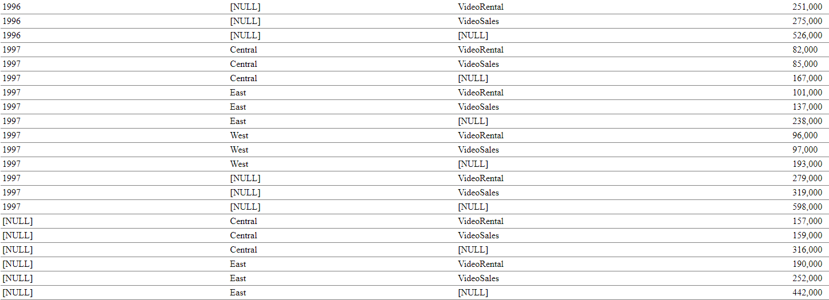
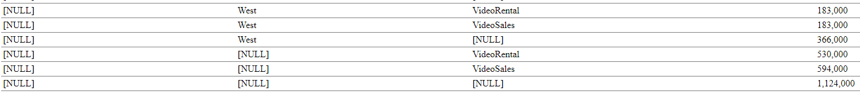
Example

Slide 22
Calculating subtotals without CUBE
Just as for ROLLUP, multiple SELECT statements combined with UNION statements could provide the same information gathered through CUBE.
However, this may require many SELECT statements: for an n-dimensional cube, 2n SELECT statements are needed.
In our 3-dimension example, this would mean issuing 8 SELECTS linked with UNION ALL.
Consider the impact of adding just one more dimension when calculating all possible combinations: the number of SELECT statements would double to 16.
The more columns used in a CUBE clause, the greater the savings versus the UNION approach.
For instance, if a four-column CUBE replaces a UNION of 16 SELECT statements, the reduction in table access is fifteen-sixteenths or 93.75%.

Slide 23
When to Use CUBE
Use CUBE in any situation requiring cross-tabular reports.
The data needed for cross-tabular reports can be generated with a single SELECT using CUBE. Like ROLLUP, CUBE can be helpful in generating summary tables.
Note that population of summary tables is even faster if the CUBE query executes in parallel.
CUBE is especially valuable in queries that use columns from multiple dimensions rather than columns representing different levels of a single dimension.
For instance, a commonly requested cross-tabulation might need subtotals for all the combinations of month/state/product.
These are three independent dimensions, and analysis of all possible subtotal combinations will be commonplace.
In contrast, a cross-tabulation showing all possible combinations of year/month/day would have several values of limited interest, since there is a natural hierarchy in the time dimension.
Subtotals such as profit by day of month summed across year would be unnecessary in most analyses.

Slide 24
Using Other Aggregate Functions with ROLLUP and CUBE
The examples in this chapter show ROLLUP and CUBE used with the SUM() operator.
While this is the most common type of aggregation, the extensions can also be used with all the other functions available to Group by clauses, for example, COUNT, AVG, MIN, MAX, STDDEV, and VARIANCE. COUNT, which is often needed in cross-tabular analyses, is likely be the second most helpful function.
Note: The DISTINCT qualifier has ambiguous semantics when combined with ROLLUP and CUBE. To minimize confusion and opportunities for error, DISTINCT is not permitted together with the extensions.

Slide 25
GROUPING Function
Two challenges arise with the use of ROLLUP and CUBE.
First, how can we programmatically determine which result set rows are subtotals, and how do we find the exact level of aggregation of a given subtotal?
We will often need to use subtotals in calculations such as percent-of-totals, so we need an easy way to determine which rows are the subtotals we seek.
Second, what happens if query results contain both stored NULL values and "NULL" values created by a ROLLUP or CUBE?
How does an application or developer differentiate between the two?
To handle these issues, Oracle 8i introduces a new function called GROUPING.
Using a single column as its argument, Grouping returns 1 when it encounters a NULL value created by a ROLLUP or CUBE operation.
That is, if the NULL indicates the row is a subtotal, GROUPING returns a 1.
Any other type of value, including a stored NULL, will return a 0.

Slide 26
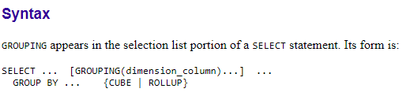
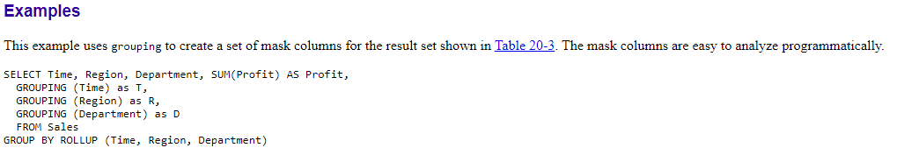
GROUPING Function

Slide 27
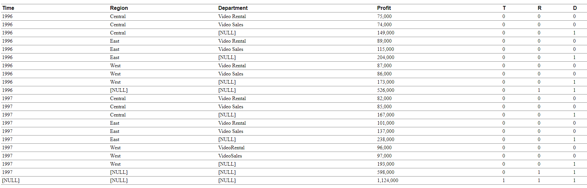
Table 20-4 Use of Grouping Function
A program can easily identify the detail rows above by a mask of "0 0 0" on the T, R, and D columns.
The first level subtotal rows have a mask of "0 0 1", the second level subtotal rows have a mask of "0 1 1", and the overall total row have a mask of "1 1 1".

Slide 28
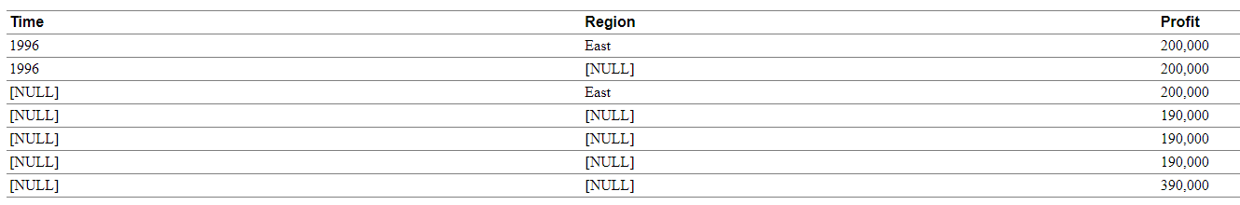
Table 20-5 shows an ambiguous result set created using the CUBE extension.
Table 20-5 Distinguishing Aggregate NULL from Stored NULL Value
In this case, four different rows show NULL for both Time and Region.
Some of those NULLs must represent aggregates due to the CUBE extension, and others must be NULLs stored in the database.
How can we tell which is which?
GROUPING functions, combined with the NVL and DECODE functions, resolve the ambiguity so that human readers can easily interpret the values.

Slide 29

AMBGUITY
We can resolve the ambiguity by using the GROUPING and other functions in the code below.
To explain the SQL statement above, we will examine its first column specification, which handles the Time column.
Look at the first line of the in the SQL code above, namely,
decode(grouping(Time), 1, 'All Times', Time) as Time,
The Time value is determined with a DECODE function that contains a GROUPING function.
The GROUPING function returns a 1 if a row value is an aggregate created by ROLLUP or CUBE, otherwise it returns a 0.
The DECODE function then operates on the GROUPING function's results.
It returns the text "All Times" if it receives a 1 and the time value from the database if it receives a 0.
Values from the database will be either a real value such as 1996 or a stored NULL.
The second column specification, displaying Region, works the same way.

Slide 30
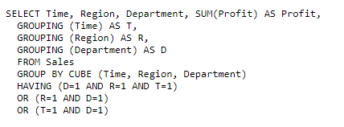
When to Use GROUPING
The GROUPING function is not only useful for identifying NULLs, it also enables sorting subtotal rows and filtering results.
In the example below (Table 20-7), we retrieve a subset of the subtotals created by a CUBE and none of the base-level aggregations.
The HAVING clause constrains columns which use GROUPING functions.

Slide 31
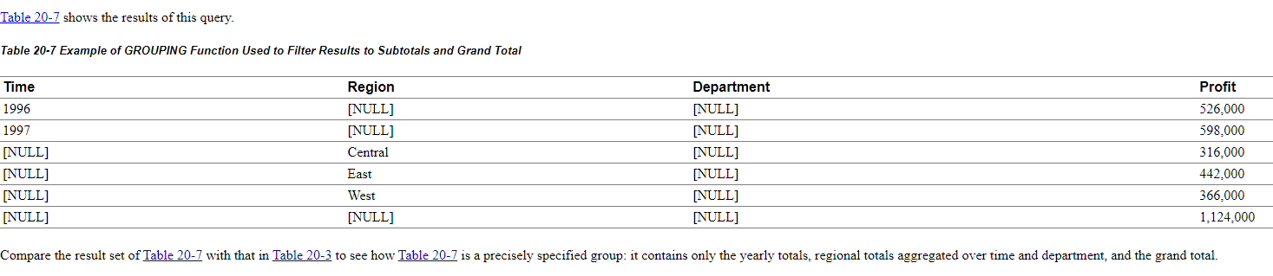
When to Use GROUPING

Slide 32

Hierarchy Handling in ROLLUP and CUBE
The ROLLUP and CUBE extensions work independently of any hierarchy metadata in your system.
Their calculations are based entirely on the columns specified in the SELECT statement in which they appear.
This approach enables CUBE and ROLLUP to be used whether or not hierarchy metadata is available.
The simplest way to handle levels in hierarchical dimensions is by using the ROLLUP extension and indicating levels explicitly through separate columns.
The code below shows a simple example of this with months rolled up to quarters and quarters rolled up to years.

Slide 33
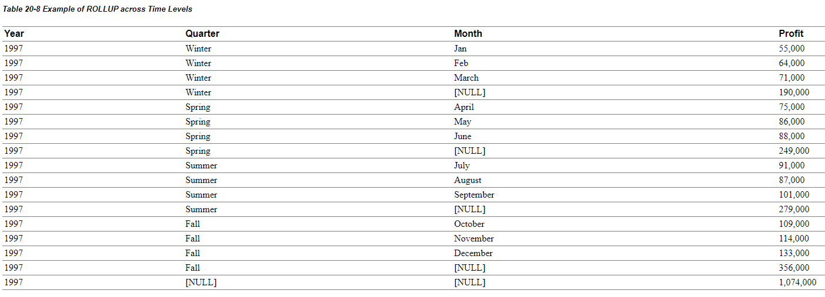
Hierarchy Handling in ROLLUP and CUBE

Slide 34
Column Capacity in ROLLUP and CUBE
CUBE and ROLLUP do not restrict the GROUP BY clause column capacity.
The GROUP BY clause, with or without the extensions, can work with up to 255 columns.
However, the combinatorial explosion of CUBE makes it unwise to specify a large number of columns with the CUBE extension.
Consider that a 20-column list for CUBE would create 2²⁰ combinations in the result set.
A very large CUBE list could strain system resources, so any such query needs to be tested carefully for performance and the load it places on the system.

Slide 35
HAVING Clause Used with ROLLUP and CUBE
The HAVING clause of SELECT statements is unaffected by the use of ROLLUP and CUBE. Note that the conditions specified in the HAVING clause apply to both the subtotal and non-subtotal rows of the result set.
In some cases a query may need to exclude the subtotal rows or the non-subtotal rows from the HAVING clause.
This can be achieved by using the GROUPING function together with the HAVING clause.
See Table 20-7 and its associated SQL for an example.

Slide 36
Overview of CUBE, ROLLUP, and Top-N Queries
The last decade has seen a tremendous increase in the use of query, reporting, and on-line analytical processing (OLAP) tools, often in conjunction with data warehouses and data marts.
Enterprises exploring new markets and facing greater competition expect these tools to provide the maximum possible decision-making value from their data resources.
Oracle expands its long-standing support for analytical applications in Oracle8i release 8.1.5 with the CUBE and ROLLUP extensions to SQL.
Oracle also provides optimized performance and simplified syntax for Top-N queries.
These enhancements make important calculations significantly easier and more efficient, enhancing database performance, scalability and simplicity.

Slide 37
Overview of CUBE, ROLLUP, and Top-N Queries
ROLLUP and CUBE are simple extensions to the SELECT statement's GROUP BY clause.
ROLLUP creates subtotals at any level of aggregation needed, from the most detailed up to a grand total.
CUBE is an extension similar to ROLLUP
CUBE can generate the information needed in cross-tab reports with a single query.
To enhance performance, both CUBE and ROLLUP are parallelized:
multiple processes can simultaneously execute both types of statements.

Slide 38
Cube and Rollup
CUBE and ROLLUP extend GROUP BY
ROLLUP builds subtotal aggregates at any level, including grand total
CUBE extends ROLLUP to calculate all possible
combinations of subtotals for a GROUP BY
Cross-tabulation reports are easy with CUBE
Oracle8i Release 2 (Oracle version 8.1.6) began release in February 2000, it’s new “Analytic” functions include: ranking, moving aggregates, period comparisons,
ratio of total, and cumulative aggregates

Slide 39
Normal GROUP BY Functionality
Normally, GROUP BY allows aggregates
(sub-totals) by specific column or set of columns
Before Oracle8i SQL required JOIN or UNION to combine subtotal information and grand totals in a single SQL query
ROLLUP creates subtotals and grand totals in the same query along with intermediate subtotals
CUBE adds cross-tabulation information based upon the GROUP BY columns

Slide 40
GROUP BY (without CUBE or ROLLUP)
Normally GROUP BY sorts on GROUP BY columns, then calculates aggregates
SQL> select deptno Department
2
3
4
5
6 /
,job
,sum(sal) "Total SAL"
from emp
group by deptno,job
DEPARTMENT JOB Total SAL
-
10 CLERK 1300
10 MANAGER 2450
10 PRESIDENT 5000
20 ANALYST 6000
20 CLERK 1900
20 MANAGER 2975
30 CLERK 950
30 MANAGER 2850
30 SALESMAN 5600

Slide 41

GROUP BY ROLLUP
ROLLUP provides aggregates at each GROUP BY level
SQL> col Department format a20 SQL> break on Department
SQL> select nvl(to_char(deptno),'Whole Company') Department
2
3
4
5
,nvl(job,'All Employees') job
,sum(sal) "Total SAL" from emp
group by rollup (deptno,job)
6 /
DEPARTMENT
JOB Total SAL
- -
10
CLERK MANAGER PRESIDENT
All Employees ANALYST
CLERK MANAGER
All Employees
CLERK MANAGER SALESMAN
All Employees All Employees
1300
2450
5000
8750
6000
1900
2975
10875
950
2850
5600
9400
29025
20
30
Whole Company

Slide 42
NULL Values in CUBE/ROLLUP Rows
Subtotal and grand total lines generated by ROLLUP substitute NULL for column values not present in the manufactured output row
The example uses the NVL function to replace NULLS
Some columns might normally contain NULL values, thus, normally occurring NULLS would be grouped with rows manufactured by ROLLUP or CUBE

Slide 43
GROUPING Function
To improve dealing with the NULL values present in the rows created by ROLLUP (and CUBE discussed later), Oracle provides the new GROUPING function
GROUPING returns a value of 1 if a row is a subtotal created by ROLLUP or CUBE, and a 0 otherwise
The following example shows the same query used previously, with DECODE used in conjunction with GROUPING to more-elegantly deal with the null values created by ROLLUP and CUBE
(Note: sample data contains no null values, the results from this query and the previous query are the same).

Slide 44
GROUPING Example
SQL> col Department format a20 SQL> break on Department
SQL> select decode(grouping(deptno),1,'Whole Company'
2
3
4
5
6
,'Department ' || to_char(deptno)) Department
,decode(grouping(job),1,'All Employees',job) job
,sum(sal) "Total SAL" from emp
GROUP BY ROLLUP (deptno,job)
/
DEPARTMENT
JOB Total SAL
- -
Department 10
CLERK MANAGER PRESIDENT
All Employees ANALYST
CLERK MANAGER
All Employees CLERK
MANAGER SALESMAN
All Employees All Employees
1300
2450
5000
8750
6000
1900
2975
10875
950
2850
5600
9400
29025
Department 20
Department 30
Whole Company

Slide 45
GROUP BY CUBE
CUBE automatically calculates all possible combinations of subtotals
SQL> select decode(grouping(deptno),1,'Whole Company','Department '
|| to_char(deptno)) Department
2
3
4
,decode(grouping(job),1,'All Employees',job) job
,sum(sal) "Total SAL"
from emp GROUP BY CUBE(deptno,job)
DEPARTMENT
JOB Total SAL
- -
Department 10
CLERK MANAGER PRESIDENT
All Employees ANALYST
CLERK
MANAGER
All Employees CLERK
MANAGER
All Employees ANALYST
CLERK MANAGER
PRESIDENT SALESMAN
All Employees
1300
2450
5000
8750
6000
1900
2975
10875
950
2850
9400
6000
4150
8275
5000
5600
29025
Department 20
Department 30
Whole Company

Slide 46
GROUP BY/ROLLUP/CUBE
CUBE add subtotals for all combinations of categories (total salary for each job type was added in the example)
If there were three GROUP BY columns (i.e. country, customer_id, product):
GROUP BY would produce aggregates each unique combination of the three columns showing the aggregate for each product ordered by each customer within each country
ROLLUP would add aggregates showing the total products by country and customer_id, total products by country, and a grand total of all products sold
CUBE would add aggregates for each product regardless of country or customer id, aggregates for each customer_id regardless of country or products ordered, and aggregates of each product by country regardless of customer id

Slide 47
CUBE/ROLLUP & Analytic Functions (8.1.6)
Combine Analytic Functions and Clauses with CUBE and ROLLUP
SQL> run
1 select decode(grouping(deptno),1,'Whole Company’
2
3
4
5
6*
,'Department ' || to_char(deptno)) Department
,decode(grouping(job),1,'All Employees',job) job
,sum(sal) "Total SAL”
,ROW_NUMBER() OVER (PARTITION BY deptno ORDER BY sum(sal)) rownbr
from emp where deptno in (10,20) group by rollup (deptno,job)
DEPARTMENT JOB Total SAL ROWNBR
Department 10 | CLERK | 1300 |  | 1
 | MANAGER | 2450 |  | 2
 | PRESIDENT | 5000 |  | 3
 | All Employees | 8750 |  | 4
Department 20 | CLERK | 1900 |  | 1
 | MANAGER | 2975 |  | 2
 | ANALYST | 6000 |  | 3
 | All Employees | 10875 |  | 4
Whole Company | All Employees | 19625 |  | 1

Slide 48
Conclusion
CUBE and ROLLUP reduce work necessary to code and create aggregates often requested by management to provide competitive or summary information
CUBE and ROLLUP provide mechanisms for using a single SQL statement to provide data that would have required multiple SQL statements, programming, or manual summarization in the past

Slide 49


